Slide 1

AVERAGE

Slide 2
Average
Introduction -Average
General results of average
Consecutive Number Average
Finding the value of article added or removed
Finding the value of article replaced
Data Sufficiency Questions

Slide 3

Average
Example: What is the average of first 10 Prime numbers?
Solution: First 10 Prime numbers are 2,3,5,7,11,13,17, 19, 23 and 29.

Slide 4
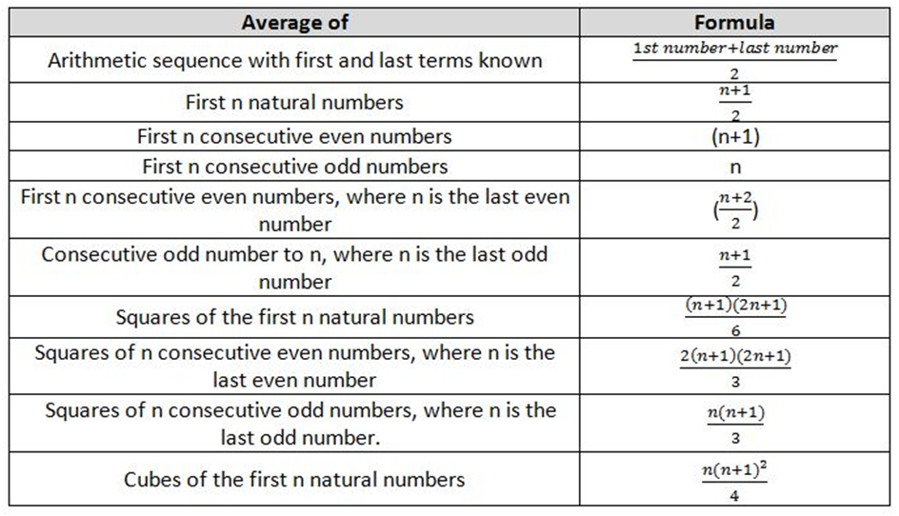
Average

Slide 5
Average
1. David obtained 76, 65, 82, 67 and 85 marks, out of 100, in English, Mathematics, Physics, Chemistry and Biology. What are his average marks?
A] 75 B] 85
C] 73 D] None of these
Notes:
Correct Option: A
Compulsory
Difficulty level: Easy

Slide 6
Average
2. The average of 1, 3, 5, 7, 9, 11,-------- to 25 terms is
A] 21 B] 19
C] 25 D] 23
Notes:
Correct Option: C
Compulsory
Difficulty level: Easy

Slide 7
Average
3. The average of the first nine integral multiples of 6 is A] 12 B] 21
C] 18 D] 30
Notes:
Correct Option: D
Compulsory
Difficulty level: Easy

Slide 8
Average
4. The average of the squares of first ten natural numbers is A] 35.5 B] 36
C] 37.5 D] 38.5
Notes:
Correct Option: D
Compulsory
Difficulty level: Moderate

Slide 9
Average
5. The average of five consecutive number odd number is 27. Find the largest of these numbers.
A] 29 B] 23
C] 31 D] 25
Notes:
Correct option: C
Compulsory
Difficulty level: Easy

Slide 10
Average
6. The average of 10 consecutive number even number is 51. Find the smallest of these numbers.
A] 40 B] 44
C] 42 D] 60
Notes:
Correct option: C
Compulsory
Difficulty level: Easy

Slide 11
Average
7. The average of 25 consecutive number number is 51. Find the largest of these numbers.
A] 60 B] 59
C] 63 D] 58
Notes:
Correct option: C
Difficulty level: Easy

Slide 12
Average
8. The average of 16 consecutive number number is 10.5. Find the largest of these numbers.
A] 18 B] 20
C] 30 D] 23
Notes:
Correct option: A
Compulsory
Difficulty level: Easy

Slide 13
Average
9. The sum of three consecutive odd number is 28 more than the average of these numbers. What is the first of these numbers? A] 15 B] 14
C] 16 D] 12
Notes:
Correct Option: D
Compulsory
Difficulty level: Moderate

Slide 14
Average
10. Average of 20 numbers is 405 . If each given number is divided by 15 . Find new average
A] 18 B] 6075
C] 27 D] 21
Notes:
Correct option: C
Compulsory
Difficulty level: Easy

Slide 15
Average
11. The average of 5 consecutive numbers is k, when 2 next consecutive numbers are added the new average of all number will be: A] k + 2 B] k + 3
C] k - 1 D] k + 1
Notes:
Correct option: D
Compulsory
Difficulty level: Moderate

Slide 16
Average
12. The average of 15 numbers is 7. If the average of the first 8 numbers is 6.5 and the average of the last 8 numbers is 8.5, then the middle number is :
A] 20 B] 15
C] 18 D] 19
Notes:
Correct Option: B
Compulsory
Difficulty level: Easy

Slide 17
Average
13. Average temperature of Monday , Tuesday , Wednesday and Thursday is 31°C , and average temperature of Tuesday , Wednesday , Thursday & Friday is 29.5°C . If temperature of Monday is 20 % more than temperature of Friday then find temperature of Friday ?
A] 36 B] 30
C] 19 D] 45
Notes:
Correct Option: B
Compulsory
Difficulty level: Moderate

Slide 18
Average
14. Average of 9 numbers is 79 . Average of first 2 numbers is 75 , average of next 4 numbers is 87 . If 8th number is 5 more than 7th number and 1 more than 9th number Find 7th number ?
A] 60 B] 65
C] 68 D] 70
Notes:
Correct Option: C
Compulsory
Difficulty level: Difficult

Slide 19
Average
Important Results:
When a person leaves the group and another person joins the group in place of that person then: A)If the average age is increased, then Age of new person = Age of separated person + (Increase in average × total number of persons) B) If the average age is decreased, then Age of new person = Age of separated person - (Decrease in average × total number of persons)
When a person leaves the group or joins the group:
A)When a new item join’s the group: New average = (old sum+ new value)/(Final number of items in the group) B) When a item leave the group: New average = (old sum - new value)/(Final number of items in the group)

Slide 20
Average
15. The average of 5 numbers is 6, when a new number is added the averages decreases by 0.5. Find the new number:
A] 1 B] 2
C] 3 D] 4
Notes:
Correct Option: C
Compulsory
Difficulty level: Easy

Slide 21
Average
16. The average of runs of a cricket player of 20 innings was 32. How many runs must he make in his next innings so as to increase his average of runs by 4?
A] 114 B] 120
C] 116 D] 114
Notes:
Correct Option: C
Difficulty level: Easy

Slide 22
Average
17. A cricketer has a certain average of runs for his 8 innings. In the ninth innings, he scores 100 runs, thereby increases his average by 9 runs. His new average of runs is
A] 14 B] 28
C] 16 D] 19
Notes:
Option b
Compulsory
Difficulty level: Easy

Slide 23
Average
18. A cricketer whose bowling average is 12.4 runs per wicket, takes 5 wickets for 26 runs and thereby decreases his average by 0.4. The number of wickets taken by him till the last match was A] 64 B] 72
C] 85 D] 80
Notes:
Correct Option: C
Compulsory
Difficulty level: Moderate

Slide 24
Average
19. Average age of 24 students and a teacher is 15 years. If age of teacher is removed then average age will decrease by one year. Find age (in years) of the teacher ?
A] 39 B] 38
C] 40 D] 45
Notes:
Correct Option A
Compulsory
Difficulty level: Easy

Slide 25
Average
20. The average of 21 numbers is 16, when a new number is excluded the averages increases by 0.5. Find the excluded number: A] 16 B] 26
C] 6 D] 9
Notes:
Correct Option: C
Difficulty level: Moderate

Slide 26
Average
21. Average of a batsman in 40 innings is 50 runs. Difference of their highest and lowest score is 172 runs and if we remove highest and lowest score innings then average becomes 48. Find highest score ?
A] 173 B] 174
C] 170 D] 171
Notes:
Option b
Compulsory
Difficulty level: Moderate

Slide 27
Average
22. The average of 100 observations was calculated as 35. It was found later, that one of the observations was misread as 83 instead of 53. The correct average is A] 32.7 B] 34.7
C] 33.7 D] 35.7
Notes:
Correct Option: B
Compulsory
Difficulty level: Easy

Slide 28
Average
23. The average of 100 numbers is 46 but it was found that 2 numbers 16 and 43 are mistakenly calculated as 61 and 34. Find the correct average.
A] 45.65 B] 46.44
C] 45.56 D] 44.46
Notes:
Option C
Compulsory
Difficulty level: Easy

Slide 29
Average
24. The average weight of 8 members group is increases by 1.5 kg when a person whose weight is 65 kg is replaced by a new person. Find weight of a new person ? A] 76 kg B] 87 kg
C] 77 kg D] None
Notes:
Correct Option: C
Compulsory
Difficulty level: Moderate

Slide 30
Average
25. Average weight of 8 members group is decreased by 2.5 kg when a person whose weight is
88 kg is replaced by a new person. Find weight of a new person ? A] 68 kg B] 78 kg
C] 77 kg D] 65 kg
Notes:
Correct Option: A
Difficulty level: Moderate

Slide 31
Average
26. The average of 50 numbers is zero. How many of them can be greater than zero, at the most? A] 25 B] 1
C] 49 D] None of them
Notes:
Correct Option: C
Compulsory
Difficulty level: Easy

Slide 32
Average
27. The average weight of 3 men A , B & C is 84 Kg. Another man D joins the group and the average now becomes 80 kg. If another man E whose weight is 3 kg more than that of D , replaces A then the average weight of B , C , D & E becomes 79 kg. What is the weight of A ? A] 70 kg B] 75 kg
C] 77 kg D] 80 kg
Notes:
Correct Option: B
Compulsory
Difficulty level: Difficult

Slide 33
Average
28. There are 42 students in a hostel. If the number of students increases by 13 expenditure on food increases by 30 Rs per day but average expenditure of per student decreases by Rs 3 . Find expenditure (in Rs) of food before increment ? A] Rs. 750 B] Rs. 630
C] Rs. 650 D] Rs. 600
Notes:
Option B
Compulsory
Difficulty level: Moderate

Slide 34
Average
29. The average age of a husband and wife who were married 4 years ago was 25 years at the time of their marriage. The average age of the husband , wife and a child who was born during the interval is 20 years now. Find present age (in years) of a child ?
A] 2 B] 4
C] 3 D] 5
Notes:
Correct Option: A
Compulsory
Difficulty level: Moderate

Slide 35
Average
30. Average age of a father , a mother and a son at the time of their son s marriage was 42 years. After 1 year, child born and after 6 years of their son’s marriage average age of the family becomes 36 years. Find age of daughter in law at the time of their marriage ? A] 22 years B] 23 years
C] 25 years D] 30 years
Notes:
Correct Option C
Compulsory
Difficulty level: Difficult

Slide 36
Average
31. The average of marks obtained by 77 candidates in a certain examination is 17 . If the average marks of passed candidates is 19 and that of the failed candidates is 8, what is the number of candidates who passed the examination ? A] 63 B] 70
C] 14 D] 56
Notes:
Correct Option A
Compulsory
Difficulty level: Moderate

Slide 37
Average
32. The average age of P, Q, R and S is 30 years. How old is R?
Statement I. The sum of ages of P and R is 60 years.
Statement II. S is 10 years younger than R.
A. I alone sufficient while II alone not sufficient to answer
B. II alone sufficient while I alone not sufficient to answer
C. Either I or II alone sufficient to answer
D. Both I and II are not sufficient to answer
E. Both I and II are necessary to answer
Notes:
Option D
Compulsory
Difficulty level: Moderate

Slide 38
Average
33. What is the salary of X in a group of X, Y, Z, whose average salary is Rs. 36,700?
Statement I. Total Salaries of Y and Z is Rs.78,650
Statement II. Total salaries of X and Y is Rs. 97,550
A. I alone sufficient while II alone not sufficient to answer
B. II alone sufficient while I alone not sufficient to answer
C. Either I or II alone sufficient to answer
D. Both I and II are not sufficient to answer
E. Both I and II are necessary to answer
Notes:
Option A
Difficulty level: Easy

Slide 39
Any Doubts???

